Slide 1

AMEO Dataset

Slide 2
About me
Background: B-tech
Why you want to learn Data Science: The main to learn data science is, I love playing but that has no use so I have started playing with data and this made me gain more interest in this field and I love making insights from the data with this all I got interest in doing this course. So that drew me interest to learn and the future is also data science.
Work experience: Fresher
Linkedin url: linkedin.com/in/tadicharlachaitanya
Github url: https://github.com/chaitu280901

Slide 3
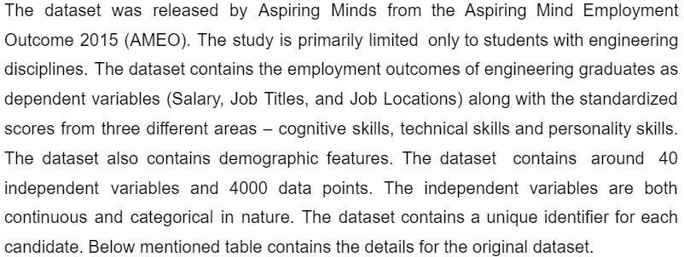
Problem Statement: Times of India article dated Jan 18, 2019 states that “After doing your Computer Science Engineering if you take up jobs as a Programming Analyst, Software Engineer, Hardware Engineer and Associate Engineer you can earn up to 2.5-3 lakhs as a fresh graduate.” Test this claim with the data given to you. Is there a relationship between gender and specialization? (i.e. Does the preference of Specialization depend on the Gender?)
Objective: To test and find if there is any relationship between gender and specialization? (i.e. Does the preference of Specialization depend on the Gender?)

Slide 4
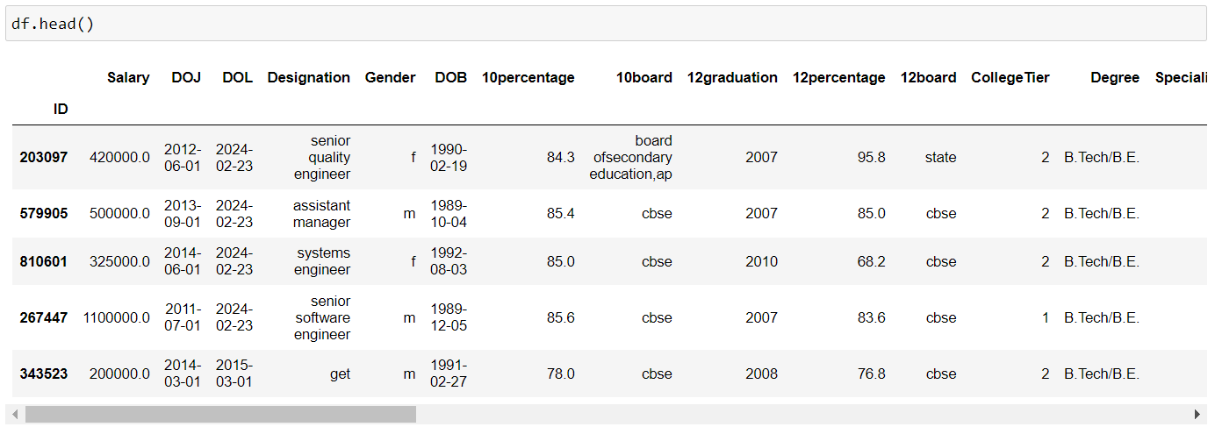
Exploratory Data Analysis:
Step -2:

Slide 5
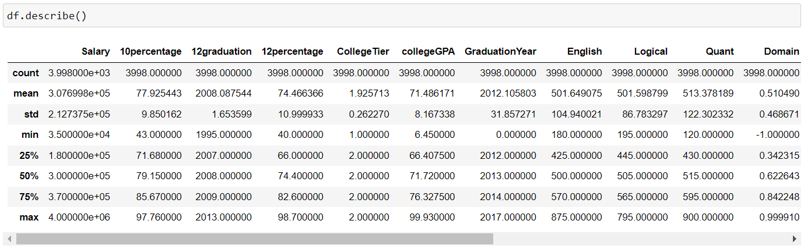
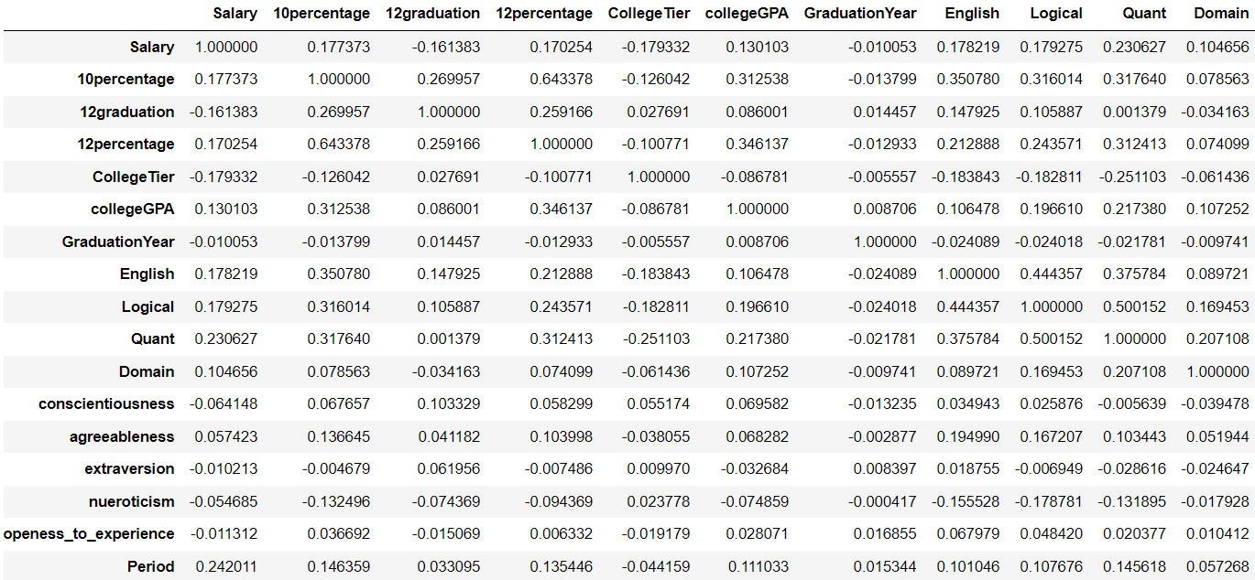

Slide 6
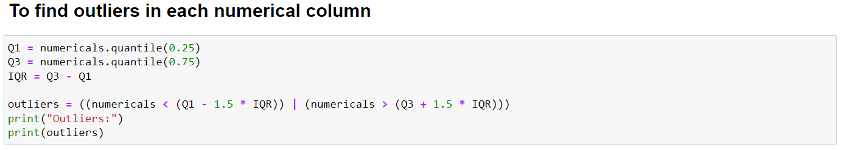
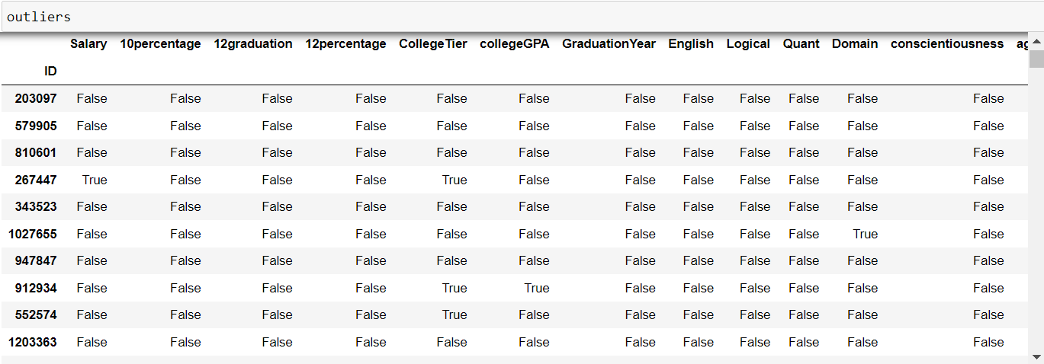
Step-3:
Univariate Analysis:

Slide 7
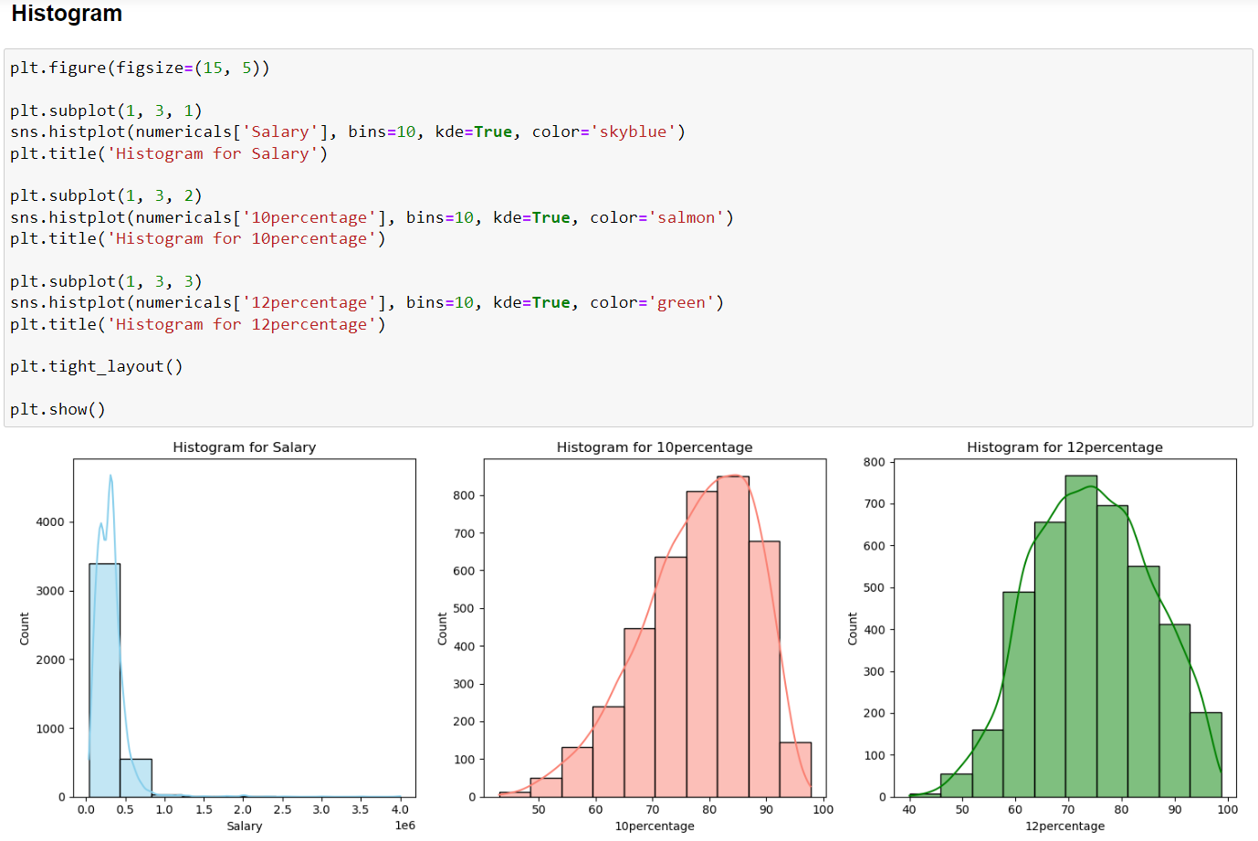

Slide 8
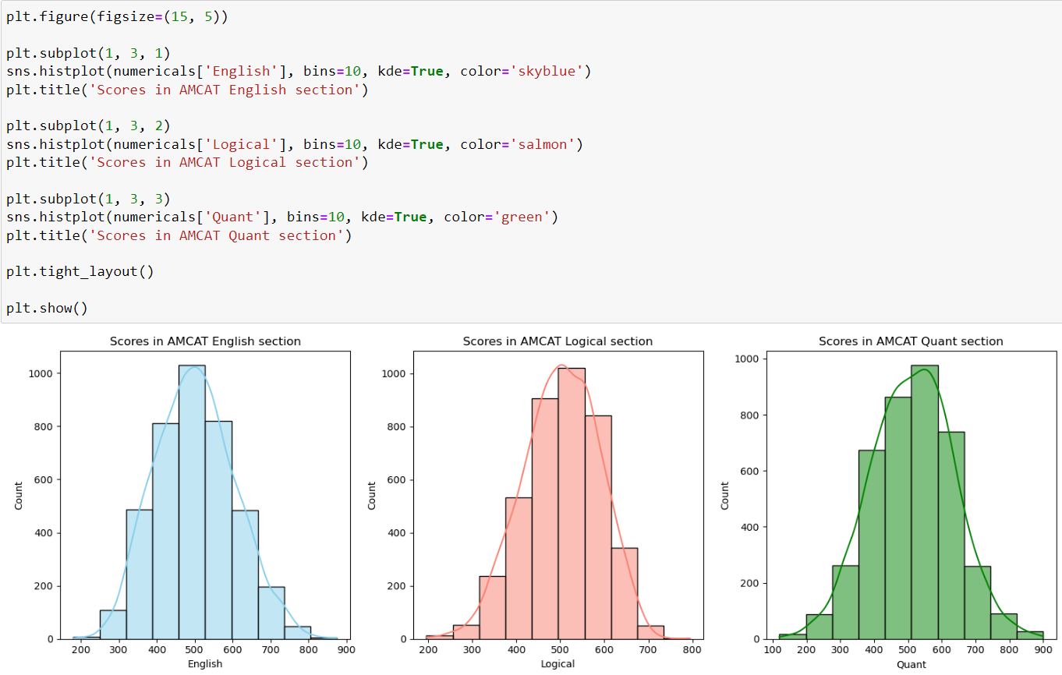

Slide 9
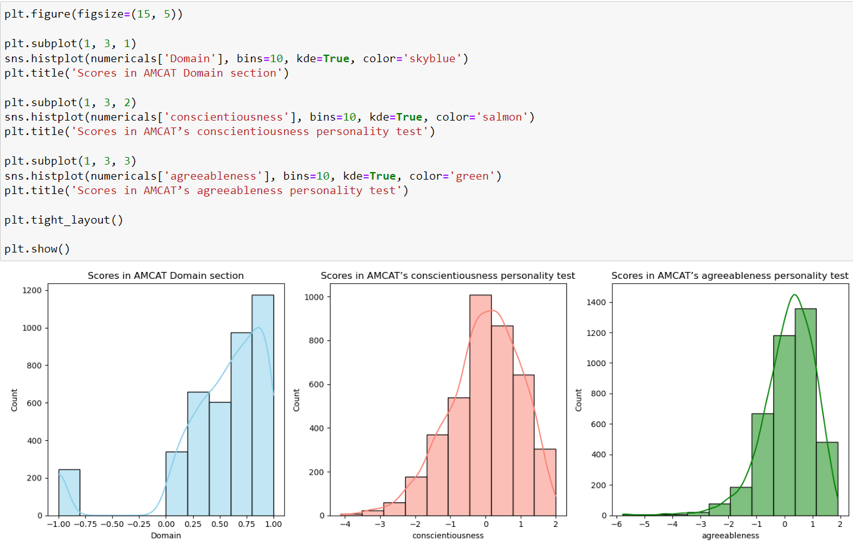

Slide 10
1st graph gives the info about salary and the count in which they are earning that particular salary. we can see that most of the people are earning below 1000000.
2nd graph gives the insights about 10th Percentage we can see that there is more density 70-90 percent which means most of them got their percentage between 70-90.
3rd hist gives info about the same percentage but in 12th standard we can see most them got between 70-75 percentage.
From the next 3 visualizations we can see the equal ratio of marks for all the three AMCAT Sections. Most of them got marks between 500-600 in all the 3 sections.
There are the scores for the personality test. The above three graphs for different personality are completely different which means they even scored in negatives in personality tests.

Slide 11
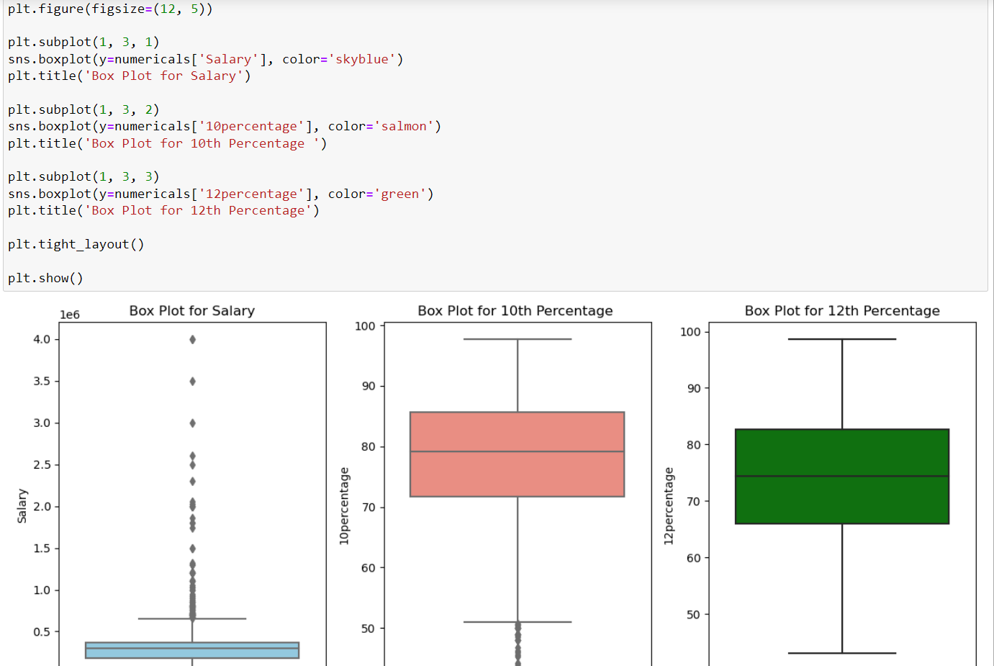
Box Plot:

Slide 12
1st box plot is visualised for salaries of employees. As we can see that the density is more in between 0.2-0.4 which means most of them getting salaries between 2lakhs to 4 lakhs adn there are many outliers which have crossed the maximum value.
2nd box plot is about the 10th percentage. As we can see that most of them scored between 70% - 85% and the median is 80%. There are also many outliers who scored more less than 50%.
3rd plot is for the 12th percentage there is only one outlier in the data for 12th percentage which is 40% and the median is 75%. Most of them got percentage between 65% to 85%.

Slide 13
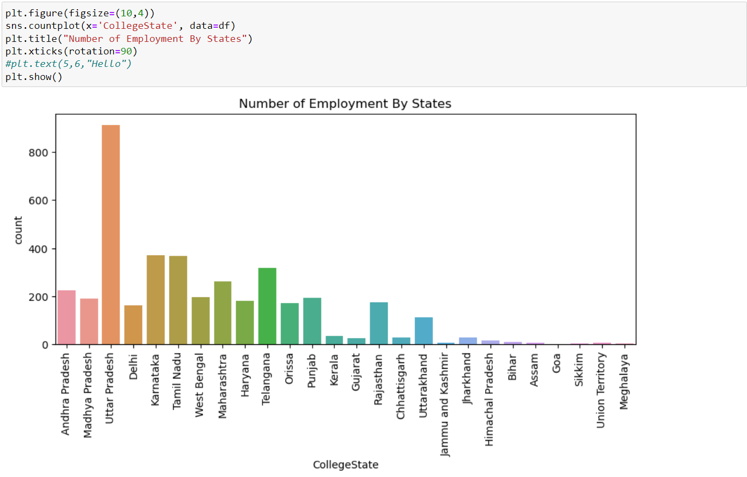

Slide 14
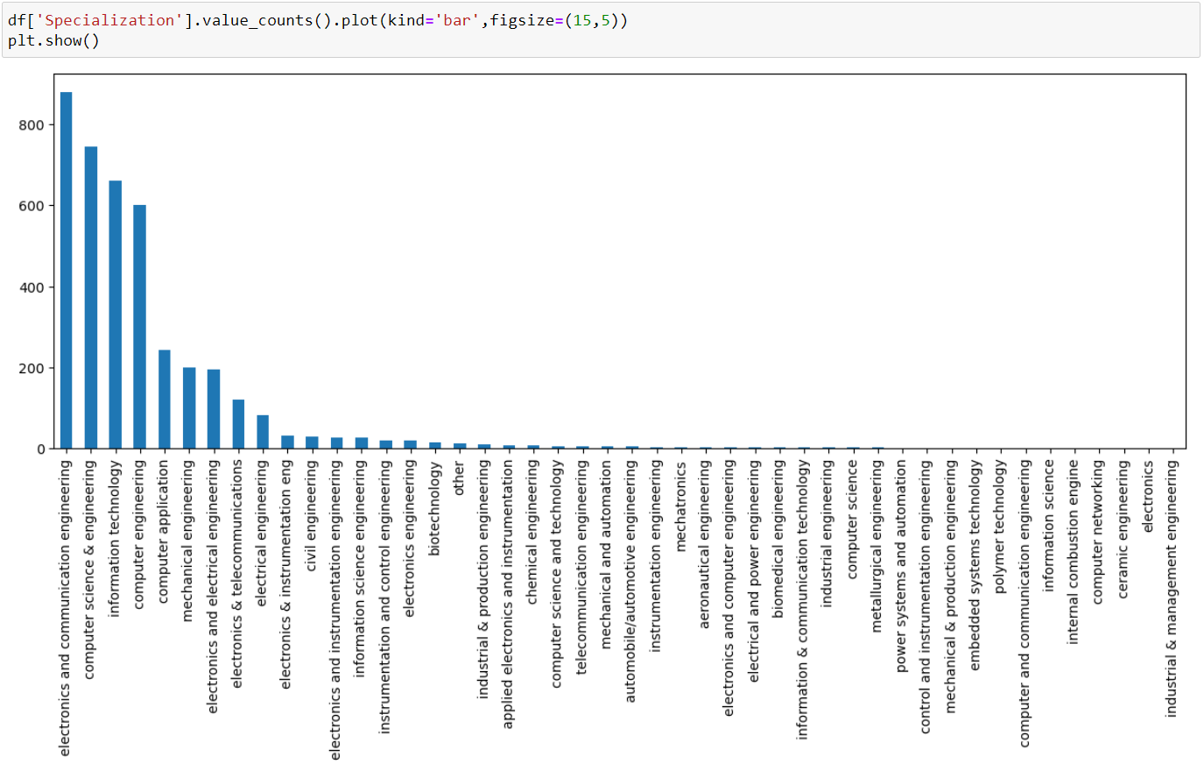
Before mapping we can see the bar graph contains many streams

Slide 15
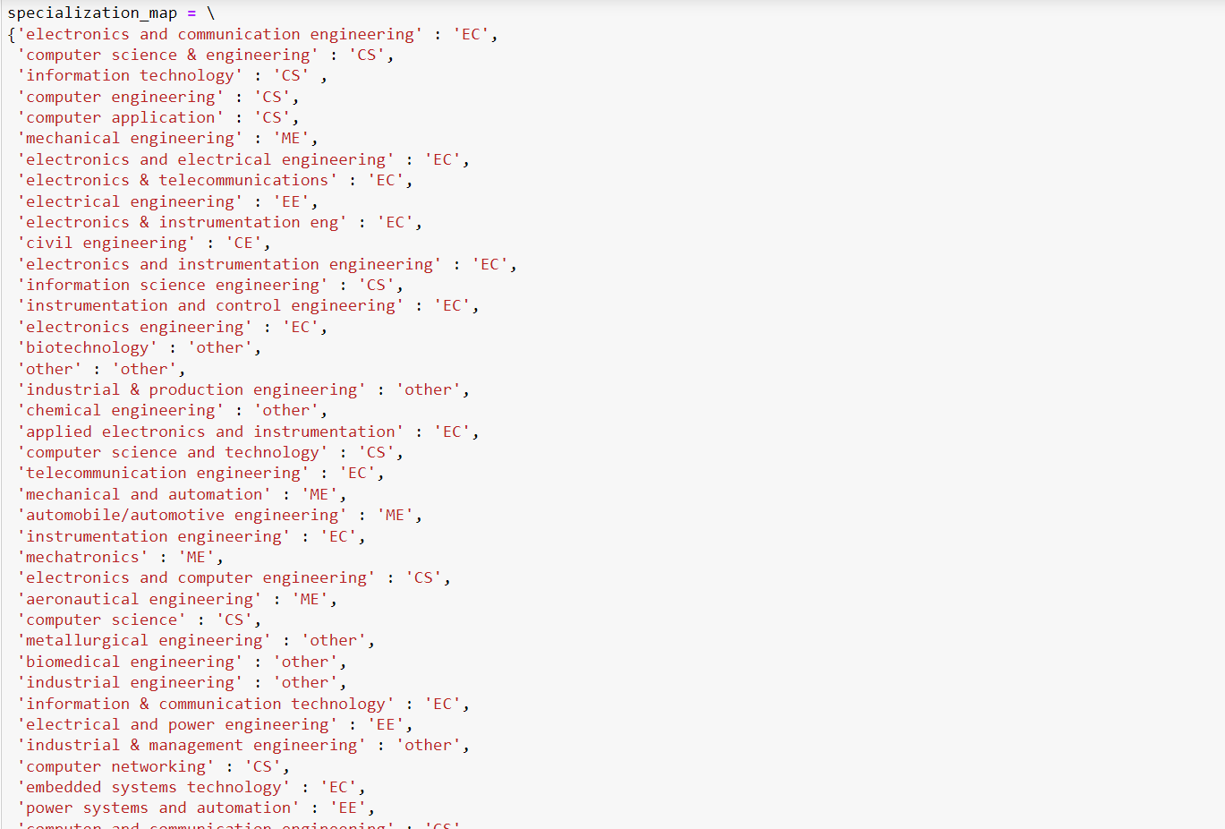
Here I have mapped every specialization to their main core branch. In the next slide we can see the bar graph with mapped specializations.

Slide 16
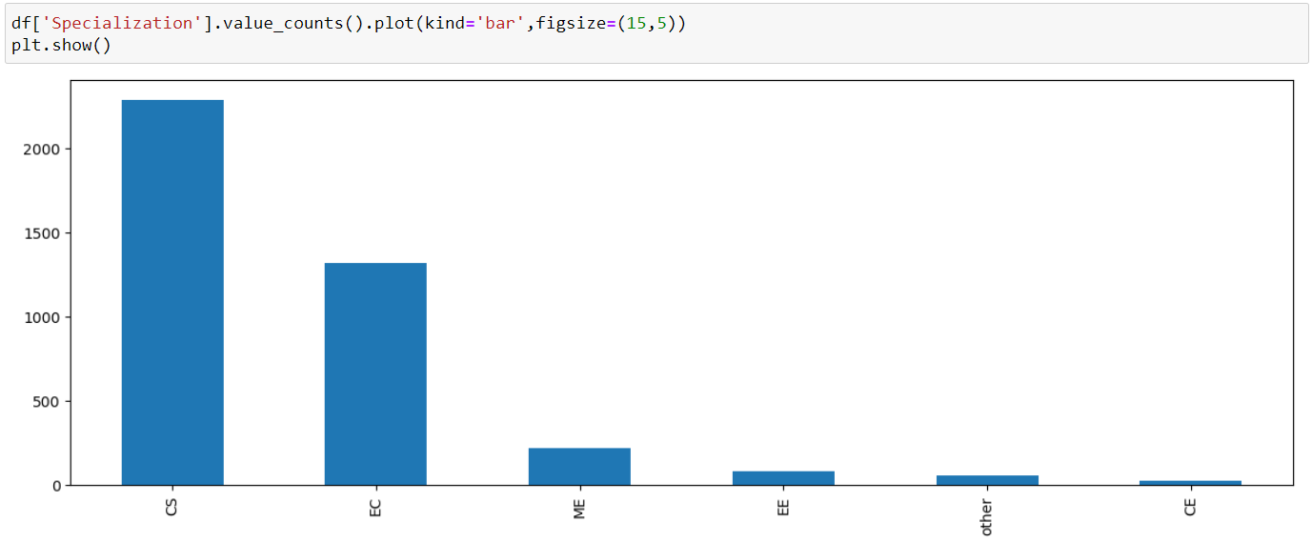
Here we can see that after mapping, the count of employees who have graduated from computers background are more and next followed by ECE background.

Slide 17
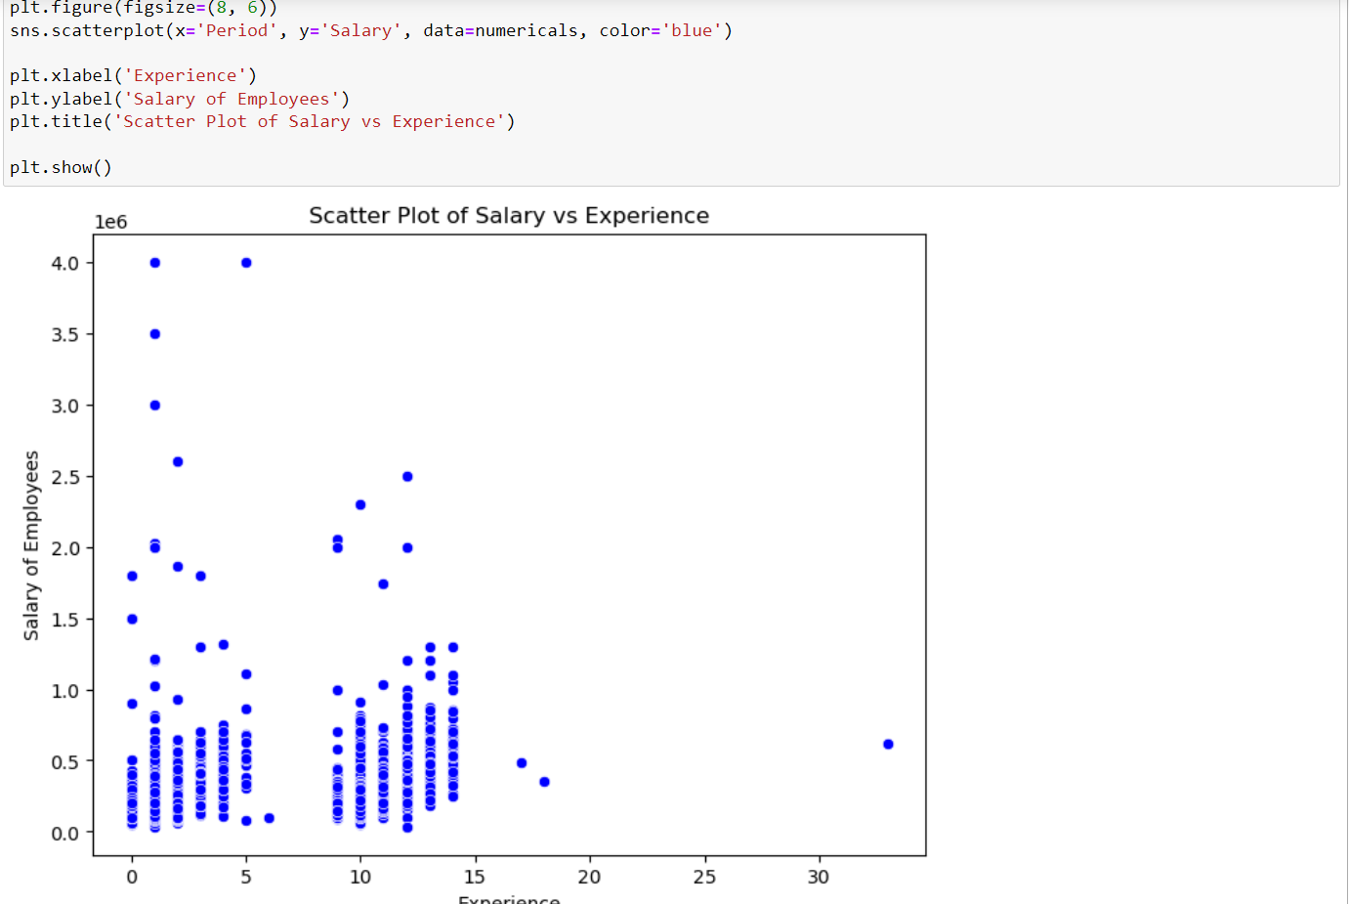
Step - 4:
Bivariate Analysis:

Slide 18
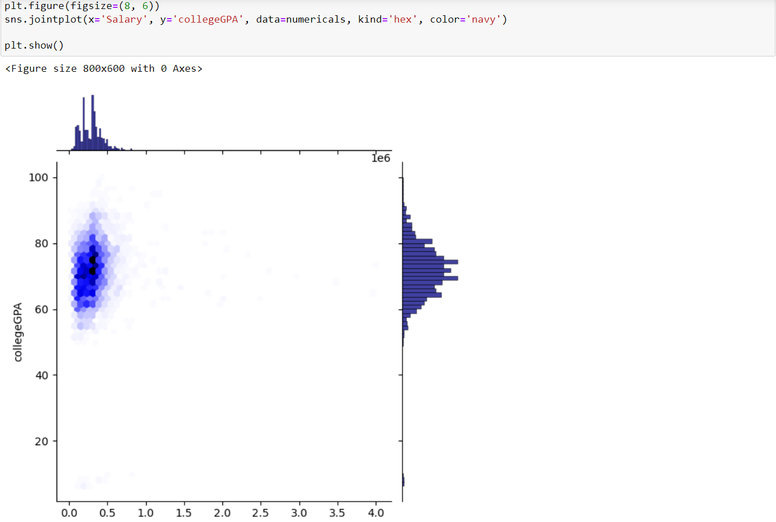
Hexbin plot:

Slide 19
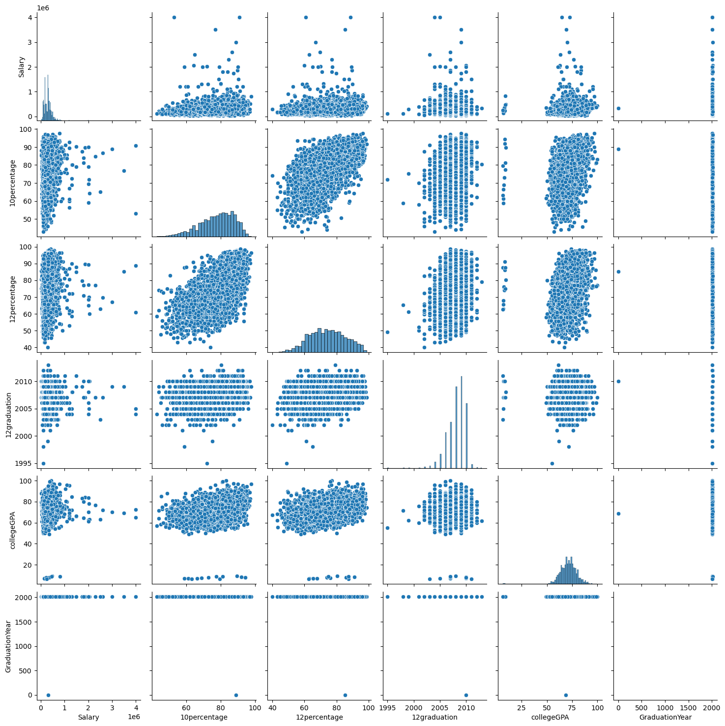

Slide 20
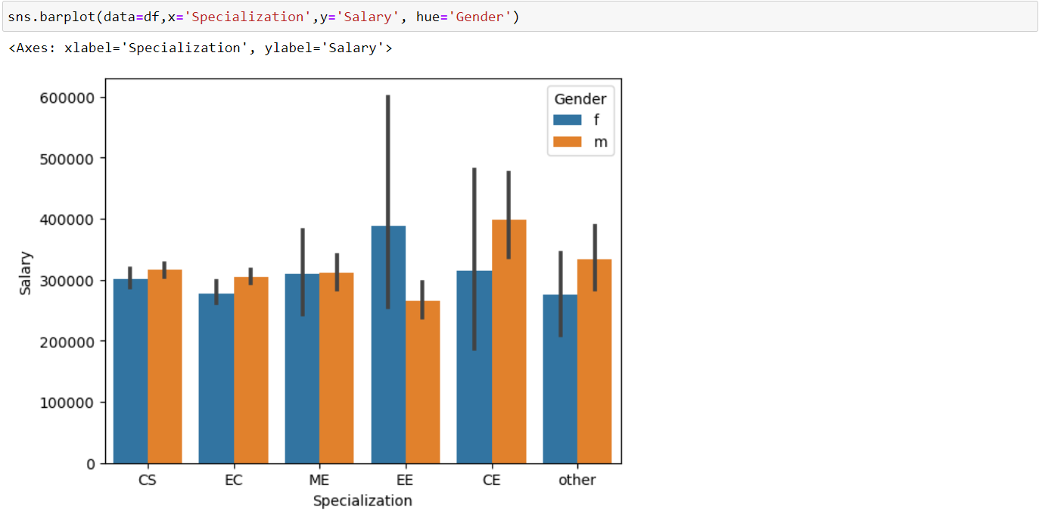
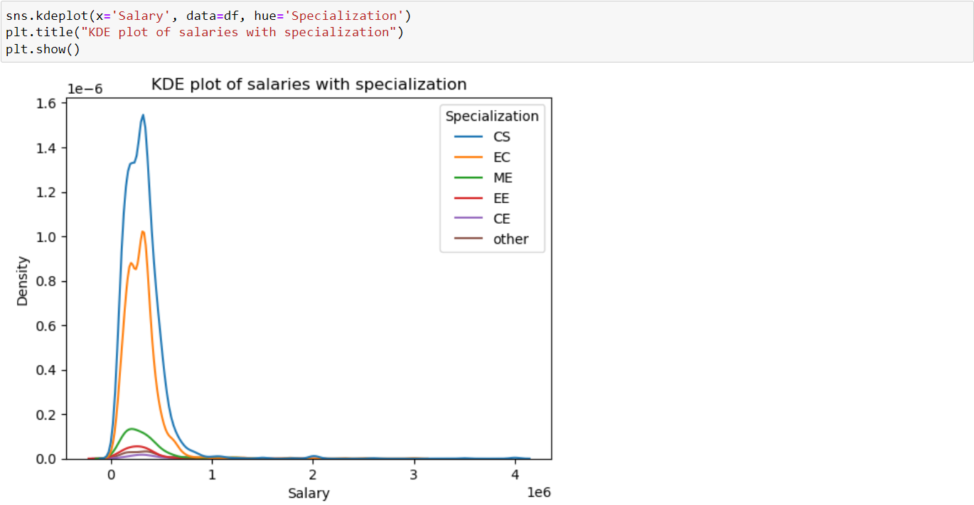

Slide 21
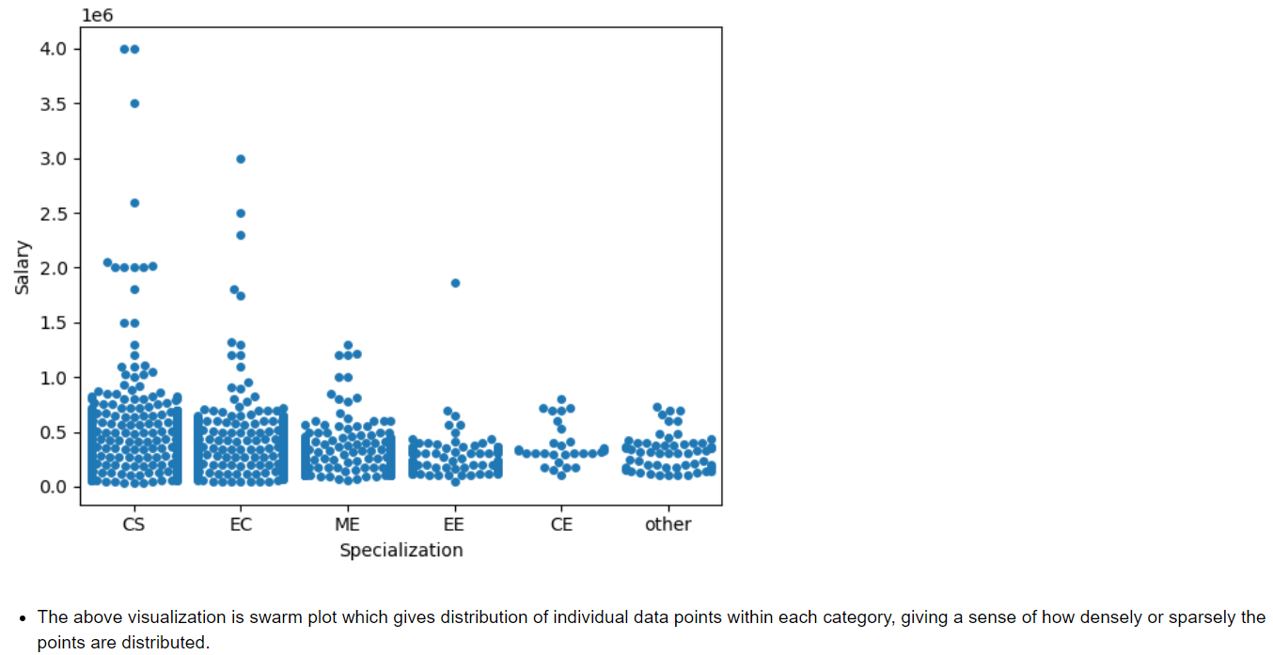

Slide 22
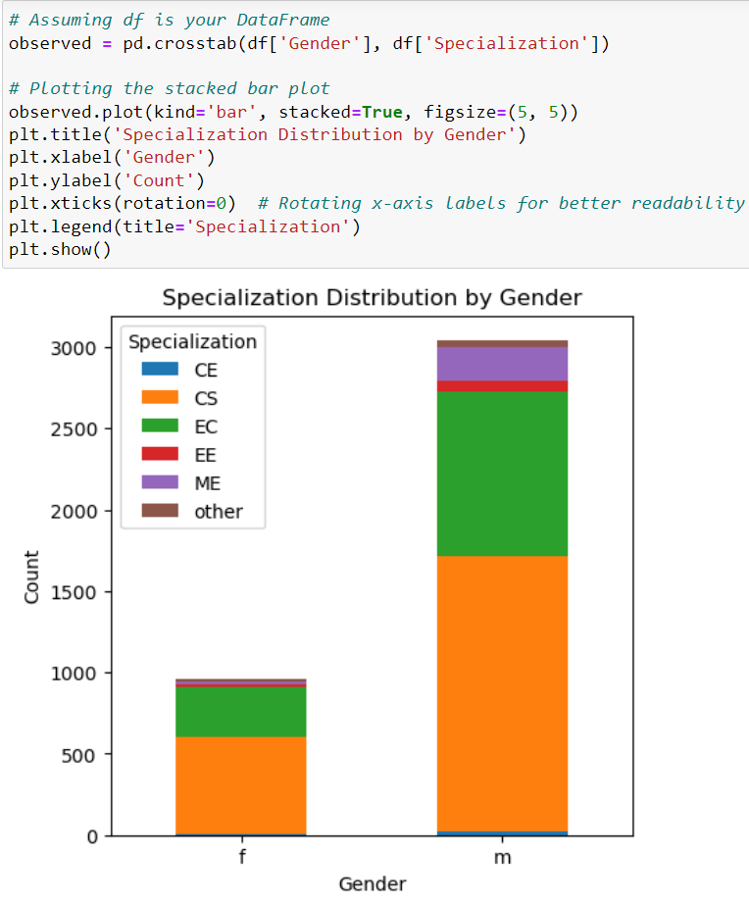
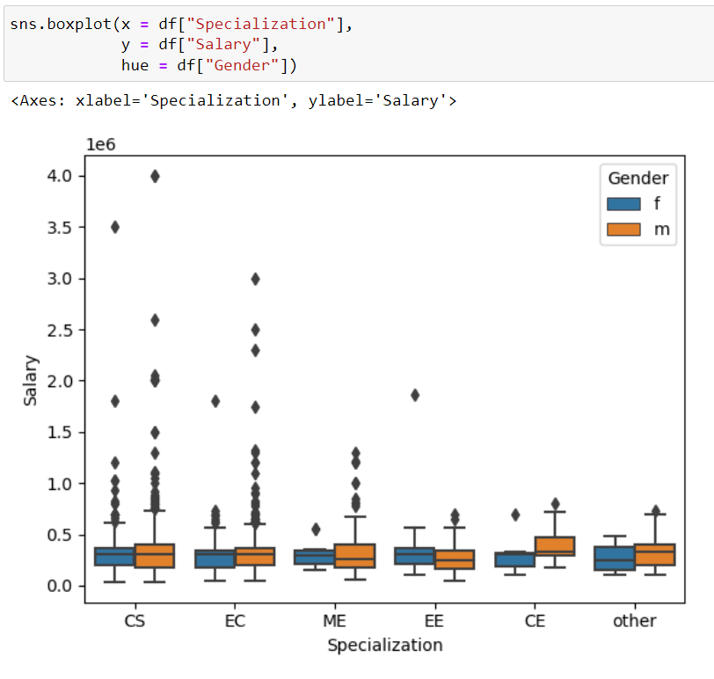

Slide 23
The above stacked bar graph is visualised to get the information between the two categorical values.
Here i considered gender with specialization to get the count of males and females wrt to specialization.
There are more number of males and females who studies CS next with ECE.
This Box plot gives the insights of salaries with specialization for both females and males.
There ae more number of outliers for CS and ECE graduates for both male and female.

Slide 24
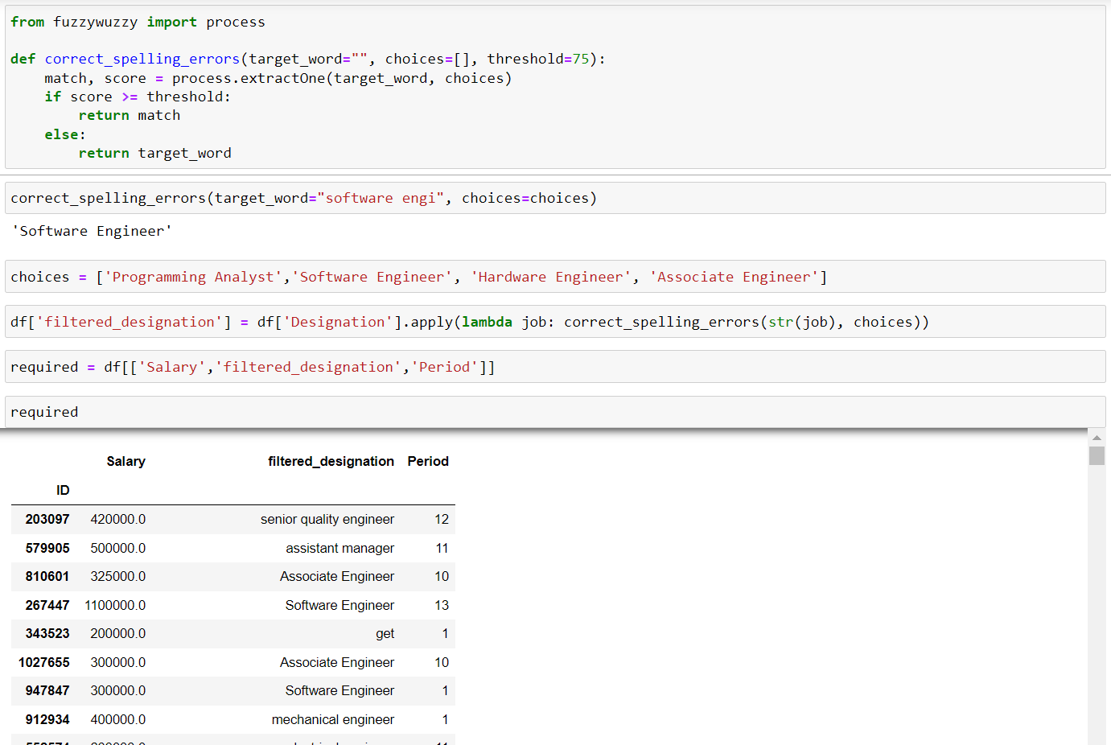
Step – 5:
Research Questions:

Slide 25
In the above slide we can see that I have used fuzzy wuzzy which is used to correct the spelling mistakes from the list of words.
Target word is what we want to correct and the correct spelling which refers to that target word must be given in the choices.
After that we use lambda function to apply the changes for the particular column and it creates the new column with the updated spellings.
In the given research question they asked for freshers so we must consider the period also which refers to the experience.
From that period we must conside ‘0’ because freshers will not have any experience.

Slide 26
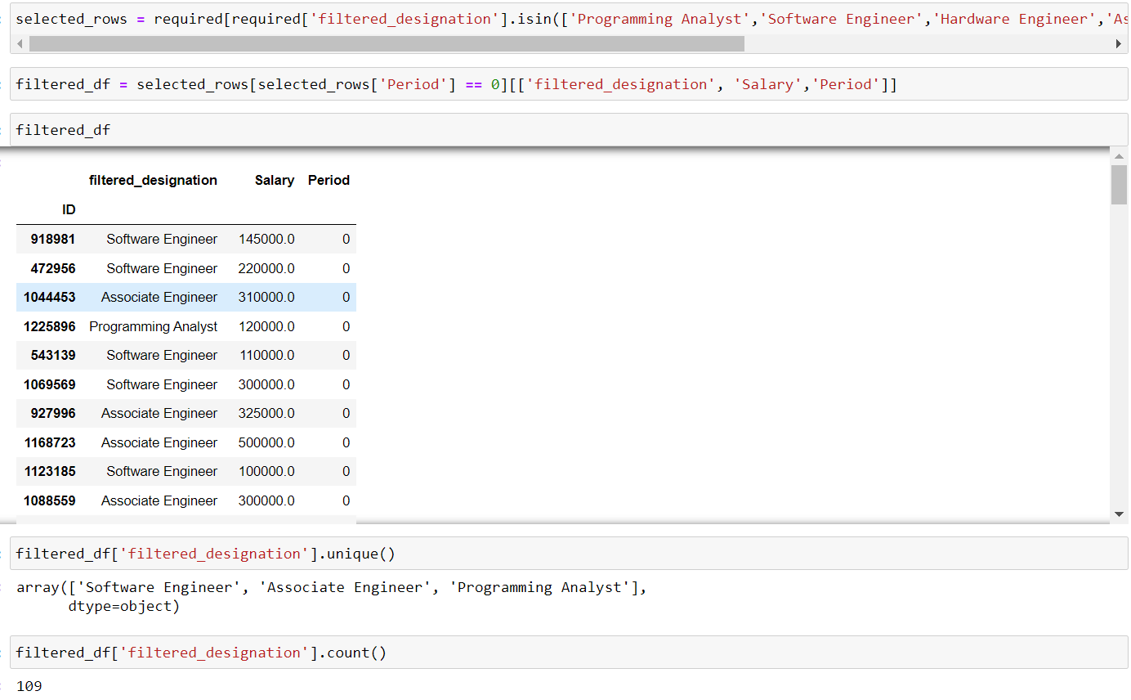

Slide 27
From newly added column we must search for the designations given in the research question. For that I have used .isin which finds the given list of words from the newly added column.
And we must extract the experience which has period 0 and the given jobs with their respective salaries.
This gives the desired output as shown in the above slide.

Slide 28
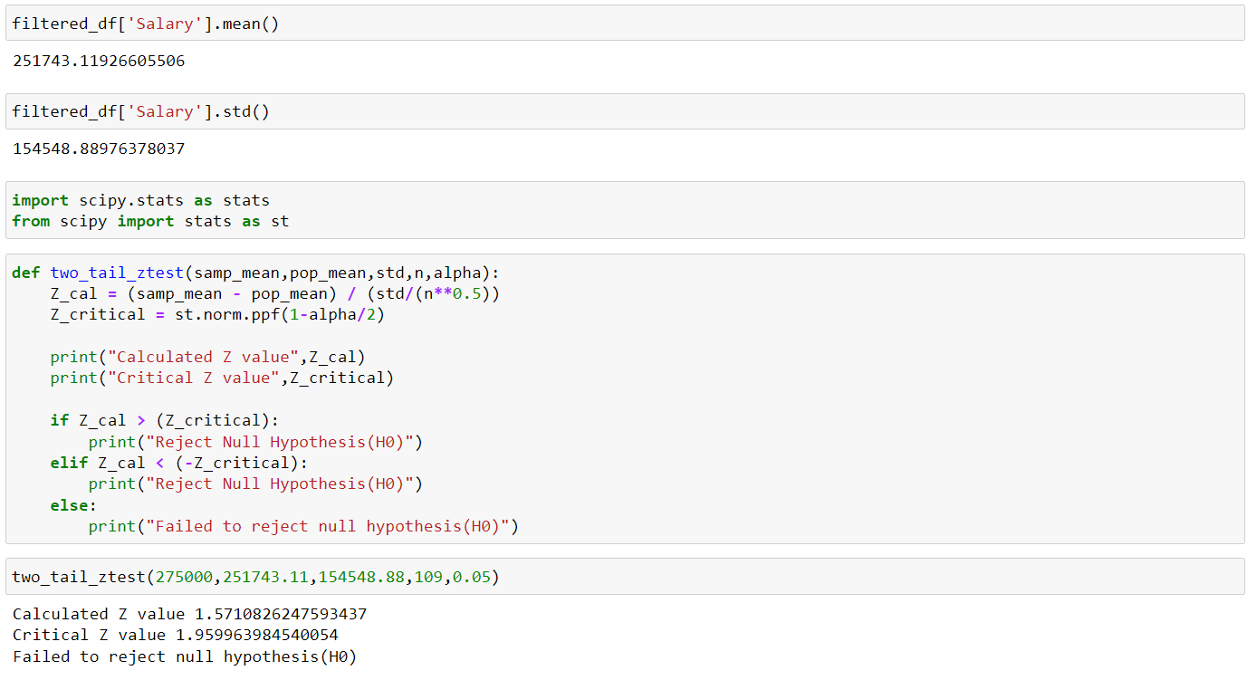

Slide 29
From the above slide we can see that I have calculated mean for the salaries.
The given mean for freshers in the research question is in between 2.5 lakhs to 3 lakhs and the calculated mean from the data I got is 2,51,743.
To test the given data we need standard deviation. To get standard deviation from the data we must use .std(), we will get standard deviation and we must consider alpha as 0.05.
Applying all the values in the code which is above slide we get the output.
The salary we got is in between the given mean range so we must reject the alternate hypothesis which means failed to reject null hypothesis.

Slide 30

THANK YOU

